Slide 1
System Development Life Cycle
Course No : CSE 3119
Course title: Information System and Software Engineering
Report on : Bangladesh Bank Management System
Bangladesh Bank Khulna Branch
Course Teacher:
Md. Abdus Salim Mollah
Assistant Professor
Department of Computer Science and Engineering
Khulna University of Engineering and Technology
Khulna -9203 ,Bangladesh

Slide 2
Presented by:
Zaima Zarnaz _1607090
Mehedi Hasan Shuvo_1607091
Sazid Karim_1607092
Delowar Sikder_1607094
Computer Science and Engineering
Khulna University of Engineering and Technology
Khulna -9203 ,Bangladesh

Slide 3
What is SDLC?
The systems development life cycle (SDLC) is a conceptual model used in project management that describes the stages involved in an information system development project, from an initial feasibility study through maintenance of the completed application.

Slide 4
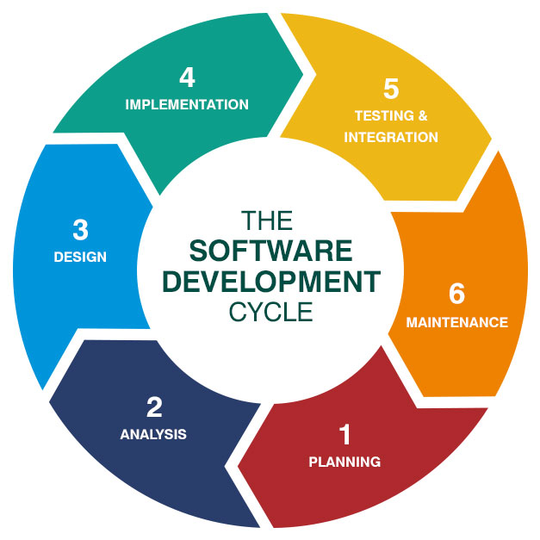
Stages of SDLC

Slide 5
1.Recognition of Need
Lack of usage of digitized systems in transaction management and monetary affairs.
Irregular Update of software and website. Information found on sites and software is severely outdated.
The system relies on manual staff in all areas of error detection and checking, in place of using automation. This has previously proven to be an ineffective approach.

Slide 6
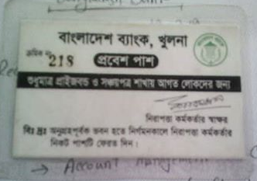

Slide 7
2 . Feasibility Study
Bangladesh Bank Management System

Slide 8
SDLC feasibility studies of Bangladesh Bank
Bangladesh Bank is a top notch organization of Bangladesh and it is considerably back dated . So, for the system development significant resources and employees can be expected .
The system being developed, will make the functionality of Bangladesh Bank significantly efficient .
So, the system fulfills the requirements of feasibility studies .

Slide 9
3.Analysis
Bangladesh BANK MANAGEMENT SYSTEM

Slide 10
SDLC Analysis of Bangladesh Bank
During this stage, the problem is defined so that a clear understanding can be gained of what the system should do, i.e. what the inputs to the system are, what the output should be, and the operational parameters within which the system is expected to work.
The documentation of the program fulfils two main objectives . The first is to provide a technical reference to facilitate ongoing maintenance and development of the software itself. The second is to provide user documentation, i.e. a set of instructions that inform the user about the features of the software and how to use them.

Slide 11
Cont..
For Bangladesh Bank, The problem of not being Modern is Defined. And a system to Modernization is required .
The system will control the information flow of Bangladesh bank totally in it’s database system which will make the bank efficient to it’s user(Local Banks) .
Of course , the security system is to be top notch for the central bank of Bangladesh .
These are the analytical life cycle of the system.

Slide 12
4.Design
Determine how the output is produced
How must be problem solved?
Find out specific solution of problem
Design of alternative solution
Implementation schedule
Approval of system by user

Slide 13
Design for Bangladesh bank
Create high security software
Come out from traditional market players in the financial industry
Appoint a specialist employee
Update software must be used
Dont browse unnecessary software from office pc

Slide 14
5.implementation
During implementation, the project team creates the needed product for the system development of BANGLADESH BANK .
The majority of the code for different programs and software are written in this implementation phase .
In this phase , the installation of newly developed system and software are done additionally .

Slide 15
implementation
The newly developed software is put into production by moving the data and components from the old system and placing them into the new system via a direct cutover .
The newly developed software helps all users (local banks and others) to maintain their dealing more easily and accurately with BANGLADESH BANK .

Slide 16


